Slide 1
Team : The NOBEL CODERS
DHRUV NARULA (TEAM HEAD)
BHAVNEET KAUR
BALRAM SURI
GAUTAM
PALAK

Slide 2

(BY NOBEL CODERS)
.

Slide 3
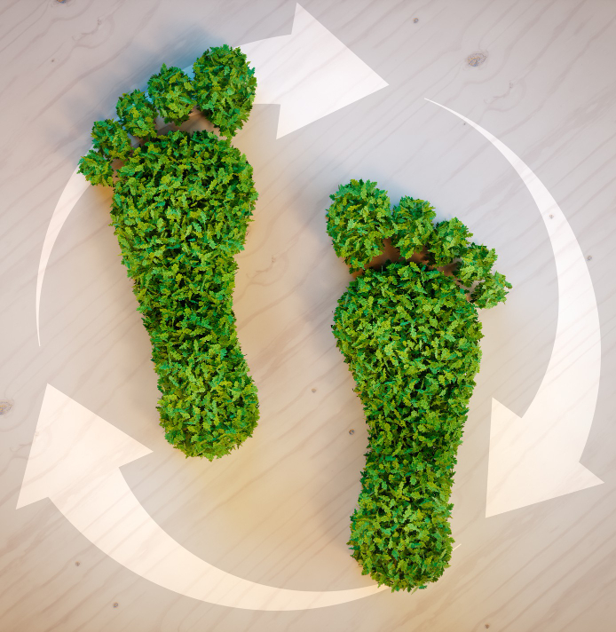
Carbon Footprint

Slide 4
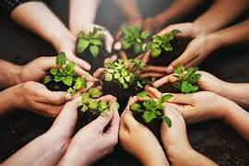
Why are we working on this project ?
The main goal is to make people aware of how their lifestyle choices affect both their health and the environment.
Foucses on pollution , water and soil impact caused by everyday activities.

Slide 5
How this project works ?
Wear the bracelet – connects to a mobile app.
Calculate environmental impact – estimates CO₂ emissions linked to choices.
Provide feedback – daily “carbon & calorie report” and eco-friendly suggestions.
Encourage change – reduce carbon footprint and stay healthy.

Slide 6

Table Of Contents
01.
History Of Carbon Footprint
02.
Carbon Equivalents
03.
Basic Calculation
04.
CO₂ Emissions Countries
05.
Conclusion

Slide 7
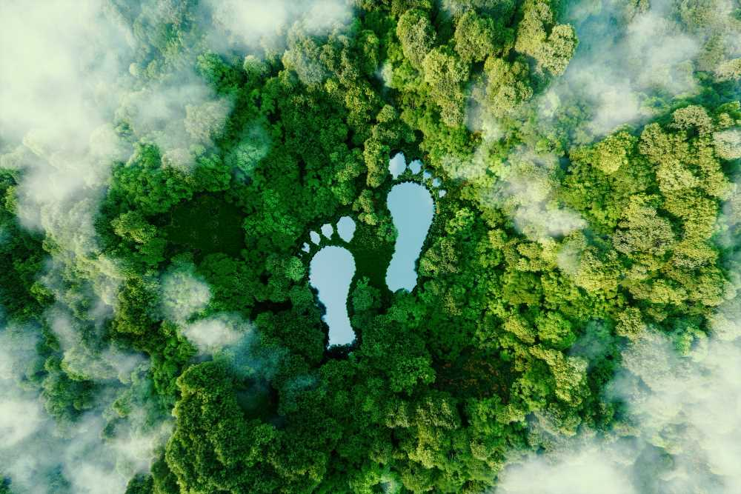
History Of Carbon Footprint?
The carbon footprint concept extends from "ecological footprints" by ecologist William Rees in the 1990s.
It quantifies GHG emissions tied to organizations, events, products, or individuals. It gained prominence in 2005, notably through a BP media campaign.

Slide 8
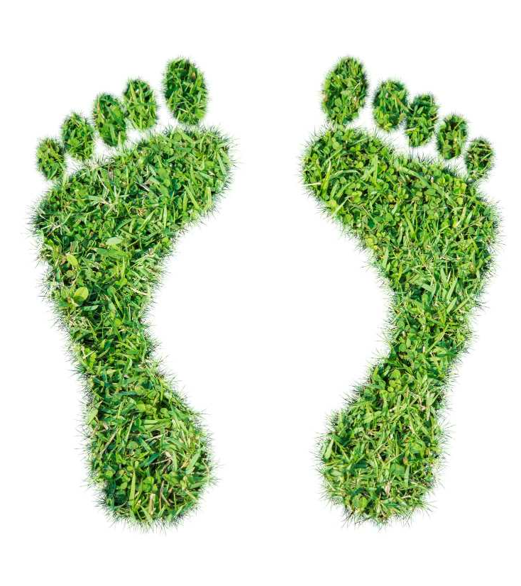
Carbon Footprint
A carbon footprint represents the collective greenhouse gas emissions, both direct and indirect, associated with human activities.
Typically, it's quantified in equivalent tons of carbon dioxide (CO2). This calculation typically covers a one-year timeframe.

Slide 9
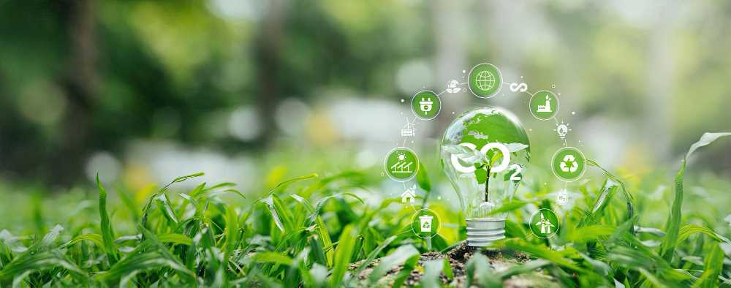
Types Of Carbon Footprints
Organisational
Value chain
Product
Include the emissions in making of a product (include only Direct emissions)
Include the emission in making as well as transport of product (include only Direct emissions)
Include the emission in procurement of raw materials, making and transport (include Direct and indirect emissions)

Slide 10
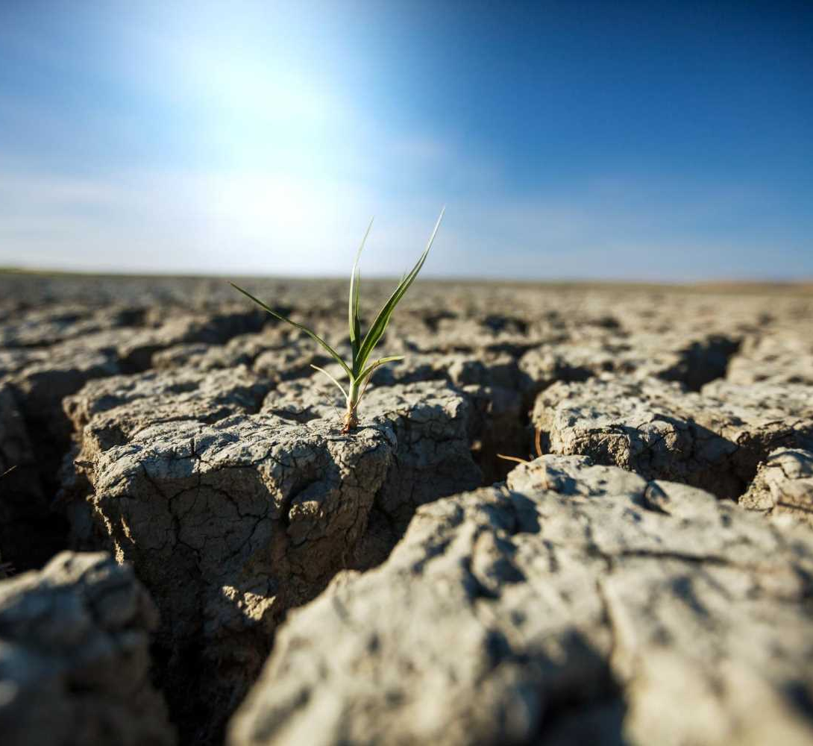
Global Warming Potential (100 Years
Carbon dioxide (CO2) | 1
Methane (CH4) | 21
Nitrous Oxide (N2o) | 310
Hydrofluorocarbons (HRCs) | 5000
Perfluorocarbons (PFCs) | 7500
Sulphur hexafluoride (SF6) | 23900

Slide 11
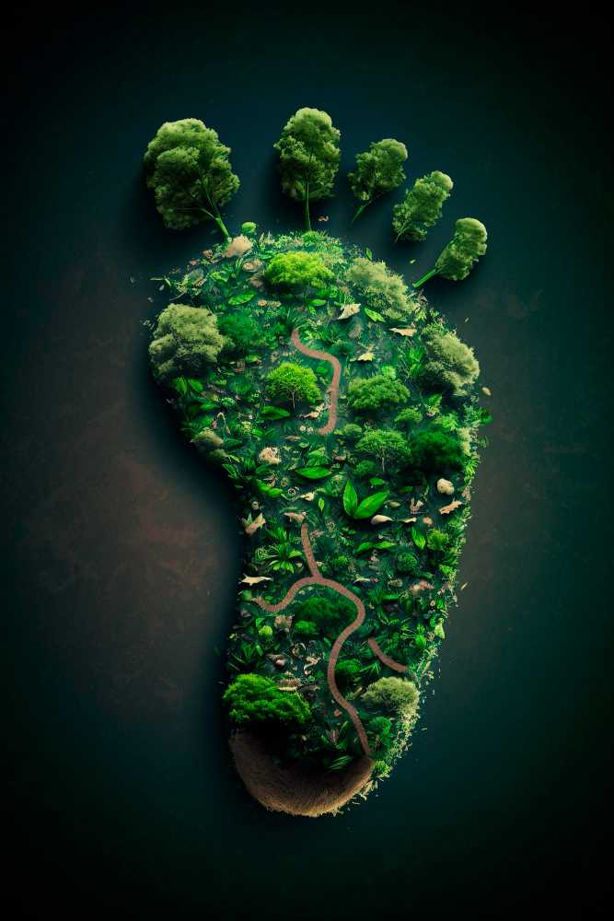

Carbon Equivalents
42
Gigatonnes of CO2 Equivalent
Human Induced Greenhouse Gas Emissions

Slide 12
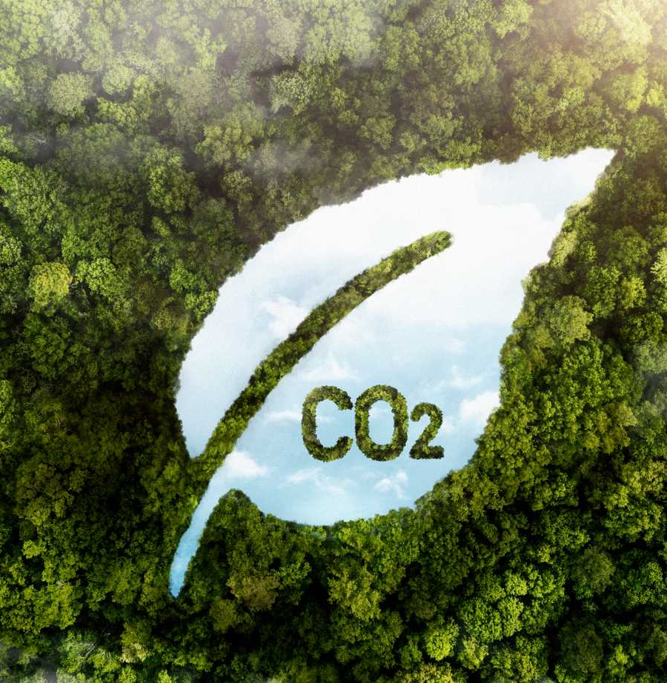
Basic Calculation
Fuel | Unit | CO2 emitted per unit
Petrol | 1 litter | 2.3 kg
Gasoline | 1 litter | 2.3 kg
Diesel | 1 litter | 2.7 kg
Oil (heating) | 1 litter | 3.0 kg
If your car consumes 7.5 liter diesel per 100 km, then a Idrive of 300 km distance consumes 3 x 7.5 = 22.5 liter - diesel, which adds 22.5 x 2.7 kg = 60.75 kg CO2 to your personal carbon footprint.

Slide 13
Personal Carbon Footprint
Each of the following activities contributes 1 kg of CO2 to your personal carbon footprint:
Travel by public transportation (train or bus) for a distance of 10 to 12 km (6.5 to 7 miles).
Drive your car for a distance of 6 km or 3.75 miles (assuming 7.3 liters of petrol per 100 km or 39 mpg).
Take a 2.2 km or 1.375-mile flight.
Operate your computer for 32 hours (assuming a 60 Watt consumption).
Using plastic bags.
Using plastic bottles.
Consuming fast foods.

Slide 14
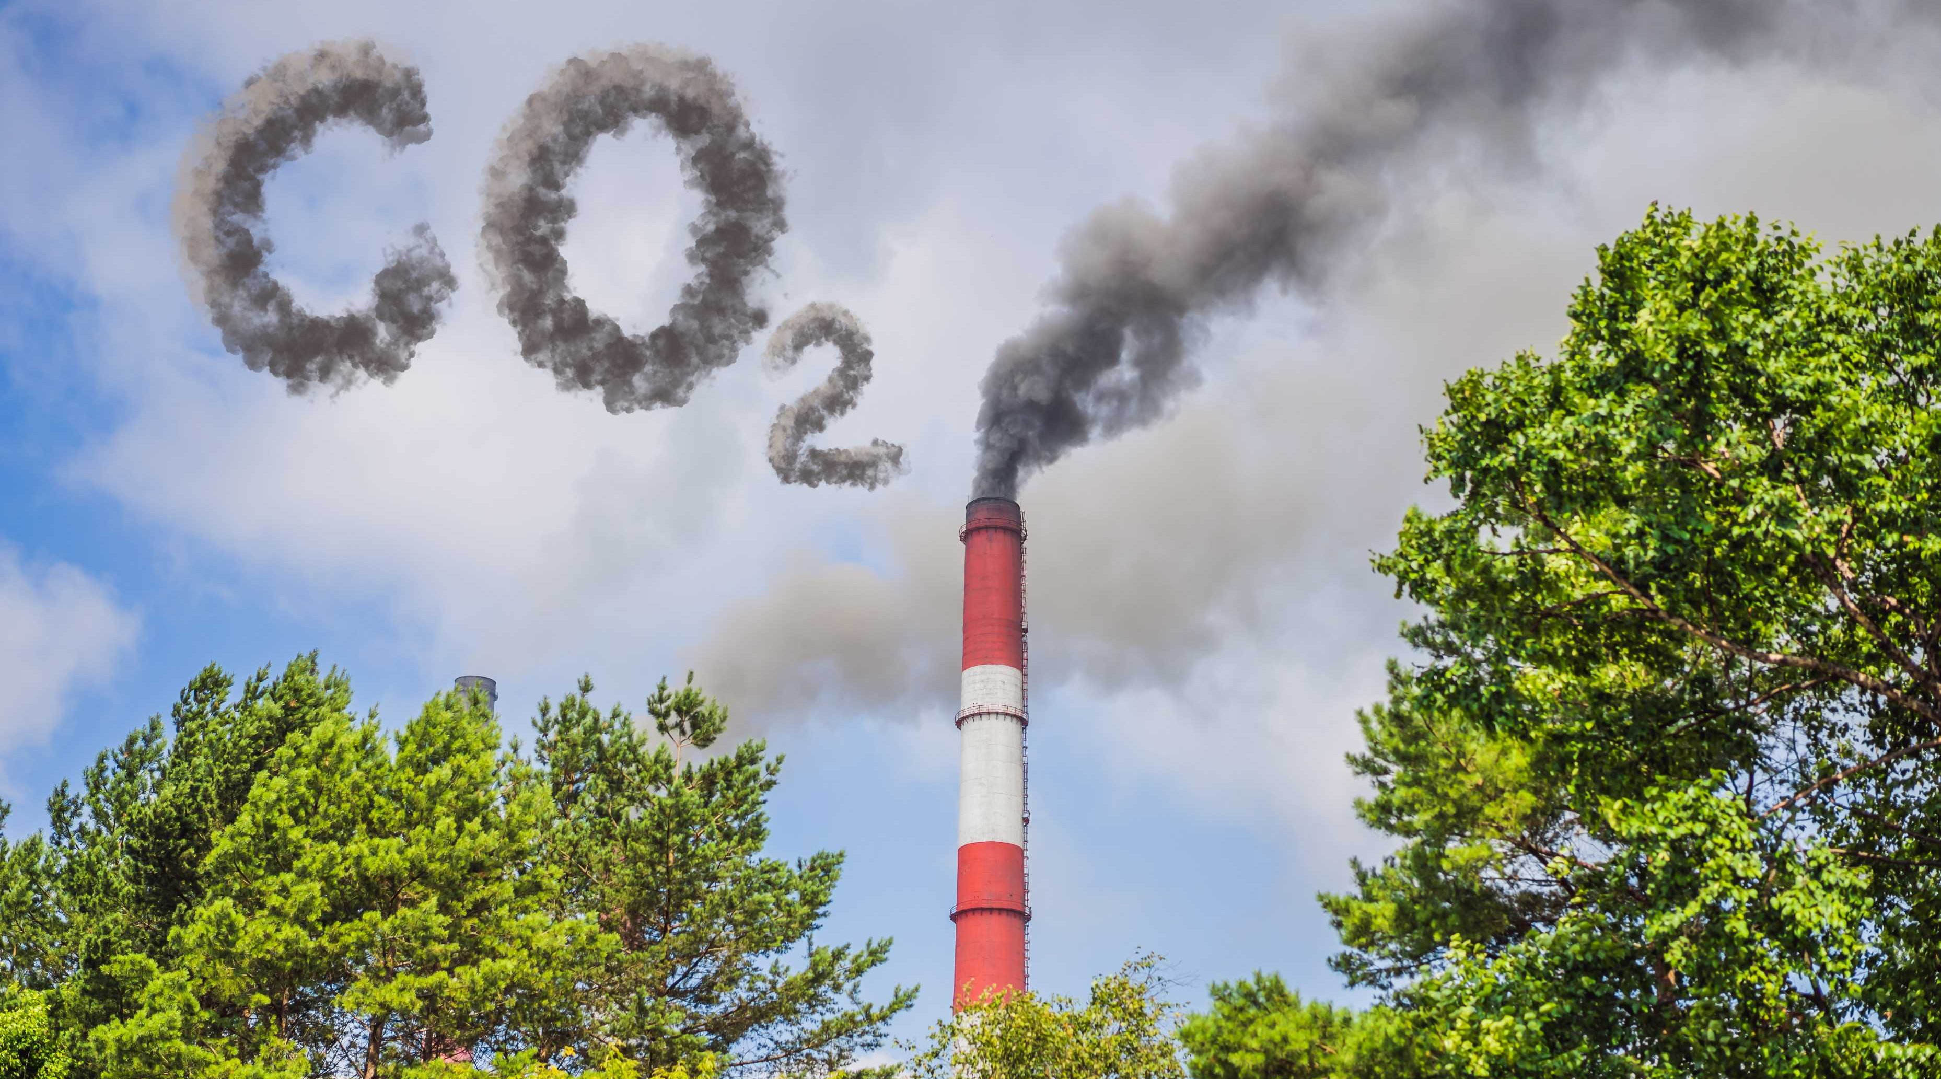
Gas | Formula | Contribution (%)
Water Vapour | H₂O | 36-72%
Carbon Dioxide | CO₂ | 9-26%
Methane | CH₄ | 4-9%
Ozone | O₃ | 3-7%
What Is GHG?
Greenhouse gases are those that can absorb and emit infrared radiation. In order, the most abundant greenhouse gases in Earth's atmosphere are:

Slide 15
CO₂ Emissions Countries, 1750-2020
(from fossil fuels and cement

Slide 16
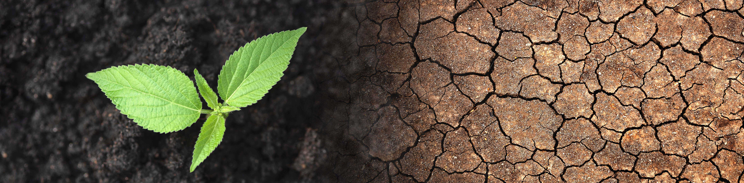
Main Effects
Climate Change
Climate change is the result of substantial carbon footprints, caused by natural and human-generated greenhouse gases. Between 1990-2005, CO2 emissions increased by 31%, leading to a 35% rise in radiative warming by 2008. Large carbon footprints also deplete resources.
Depletion of Resources Significant carbon footprints deplete resources on various scales, from deforestation on a national level to increased home air conditioning use. More significant footprints mean more greenhouse gases, intensifying climate change.

Slide 17









Emissions
H₂O
CO₂
Fuel
Electricity
Gas
Transport
Recycling
Offsets
Waste

Slide 18
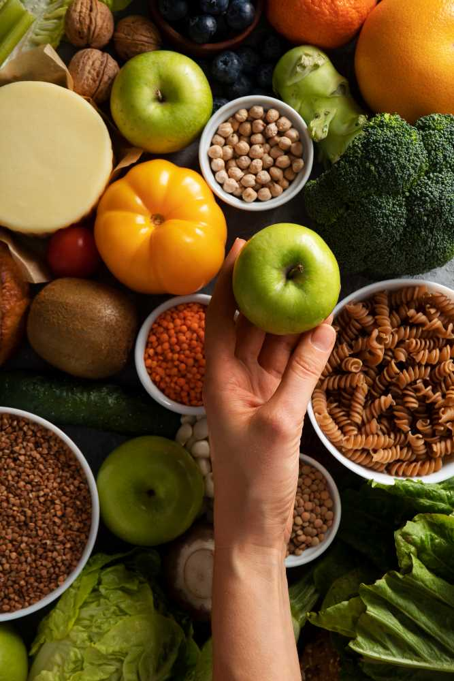
Local Produce
Support local farmers and reduce food miles.
01
Organic Options
Choose organic products with reduced chemical usage.
02
Sustainable Food Choices
Plant-Based Diets
Opt for plant-based meals to reduce carbon emissions.
03
Minimal Food Waste
Avoid food waste to reduce landfill emissions.
04

Slide 19
Conclusion
Reducing our carbon footprint is essential for a sustainable future. Each small effort, collectively, makes a significant impact in combating climate change and preserving our planet.

Slide 20
DEPENDENCIES
HTML CSS
JS [Node.Js]
BOOTSTRAP for CSS

Slide 21







Do you have a design request, please visit our Deckez site.
CREDIT: SlideEgg created this PowerPoint template.
Let this slide be kept for attribution.
www.slideegg.com

